Slide 1
XML

Slide 2
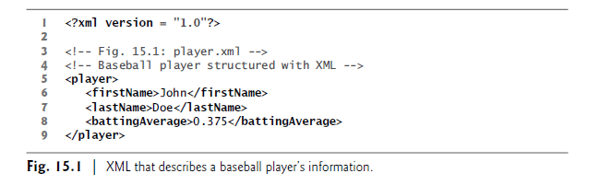
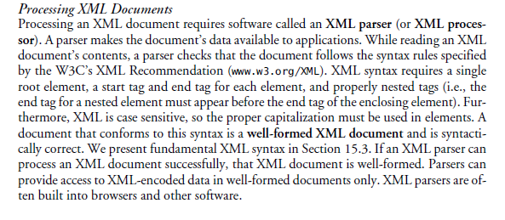

Slide 3
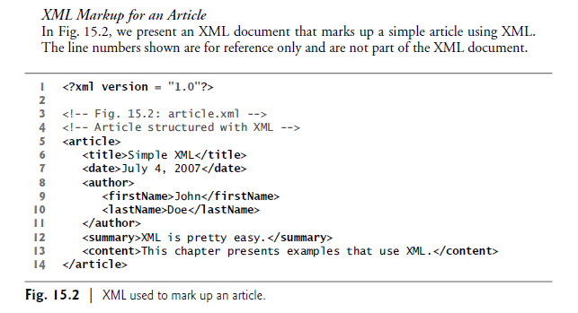

Slide 4
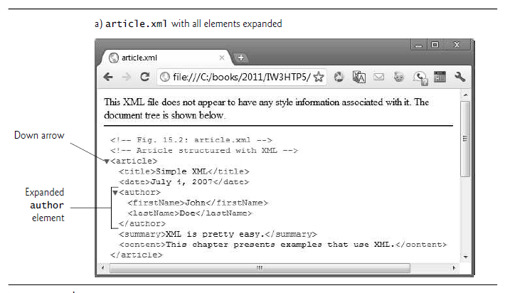
XML is case sensitive. Using different cases for the start-tag and end-tag names for the same element is a syntax error.

Slide 5
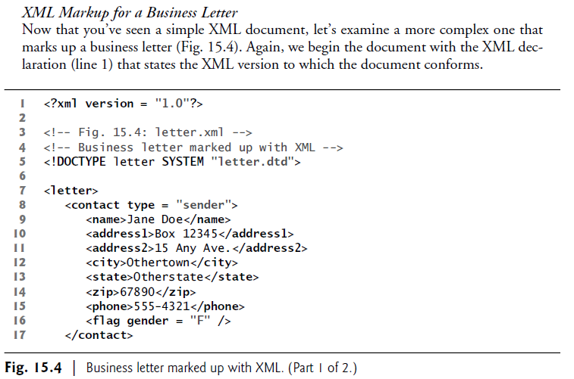

Slide 6
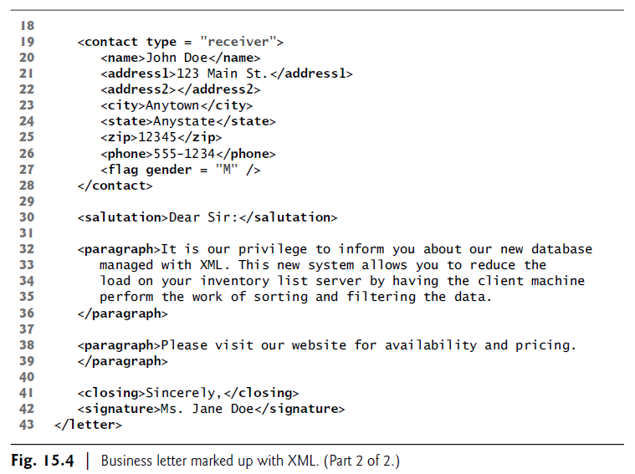

Slide 7
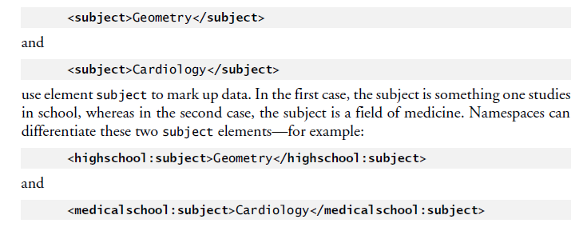
XML Namespaces

Slide 8
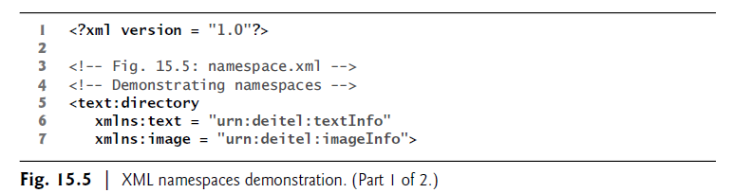
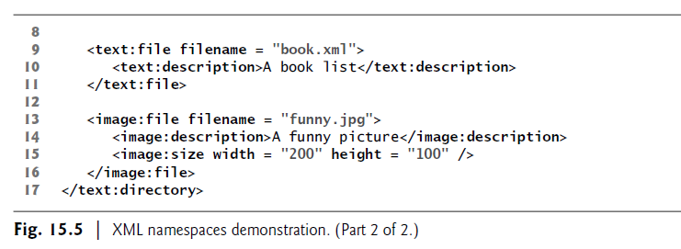

Slide 9
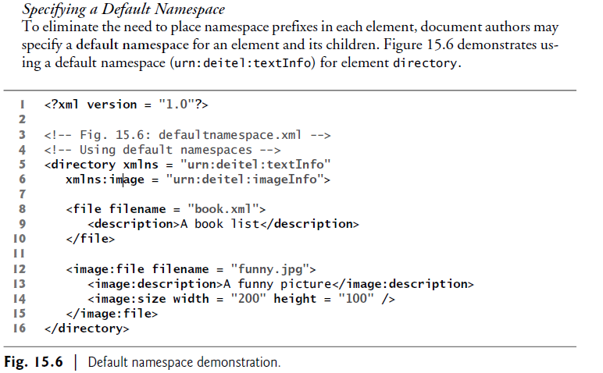

Slide 10
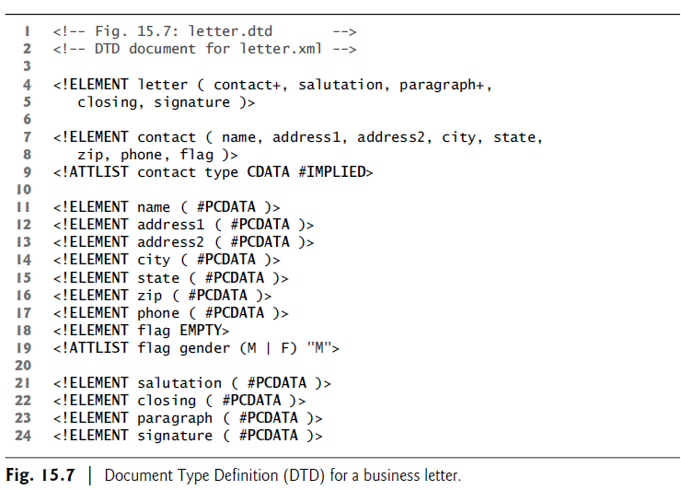
Document Type Definitions (DTDs)

Slide 11
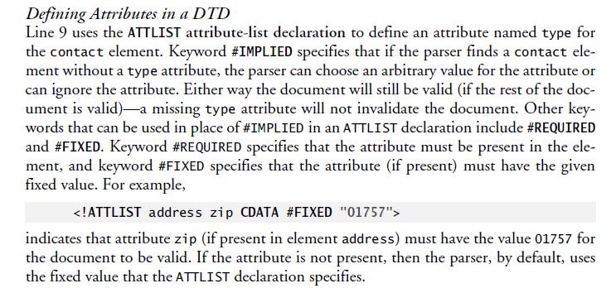
The plus sign (+) occurrence indicator specifies that the DTD requires one or
more occurrences of an element. Other occurrence indicators include the asterisk (*), which indicates an optional element that can occur zero or more times, and the question mark (?), which indicates an optional element that can occur at most once (i.e., zero or one occurrence).

Slide 12
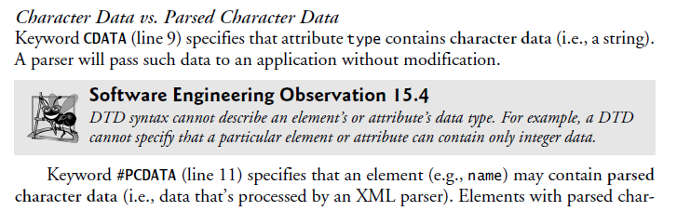
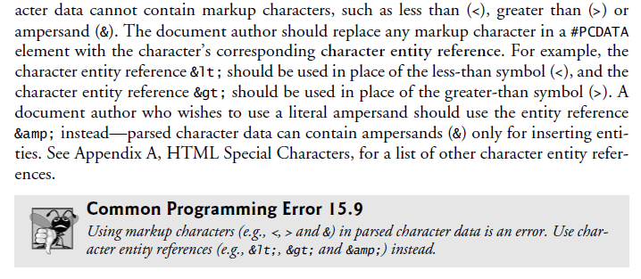

Slide 13
